Slide 1
Face Recognition
Using PCA and SVMs

Slide 2
Problem Definition
Using Principal Component Analysis and Support Vector Machine classifier, we are matching the images of the people (facing in different direction, under different lighting conditions, having various facial expressions) to the correct person(label).

Slide 3
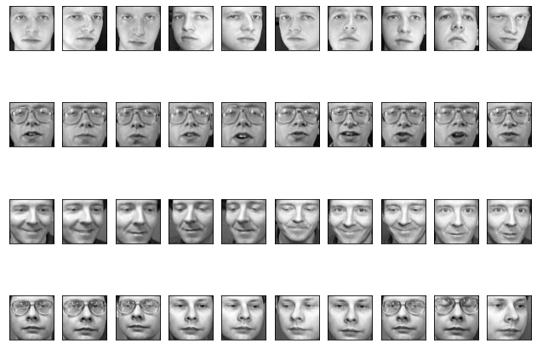
Background
Dataset contains images of 40 people. There are 10 images of each person. So in total there are 400 images in dataset. The size of the each image is 64*64 pixels. Here is set of images of first four people.Each person is labelled as 0,1,2… and so on.

Slide 4
Mathematical Details and Implementations
In order to apply PCA, images are converted into a vector of size [1*4096]. Repeating the process for all the images, we get data frame of size (400*4096).
In PCA, we find the mean and covariance matrix of all the elements in the dataframe. After that we find eigenvalues and eigenvectors (here eigenfaces) of the covariance matrix. We choose top n-eigenfaces (in the descending order of their eigenvalues).
The value of ‘n’ is chosen such that sum of the percentage of the variance explained by first n-components is greater than 90%.

Slide 5
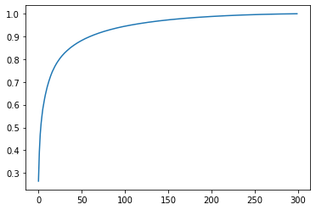
We plot the graph between cumulative sum of percentage variance and components.
Here at 100 components cumulative variance percentage ratio>90%. Thus we can choose
N-components = 100.

Slide 6
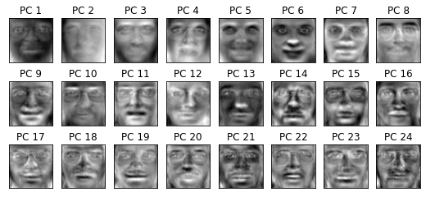
Some of the eigenfaces are shown below.
Unprocessed images
Eigne faces

Slide 7
Now project the input image on the the principal components(eigen faces). By projection we get the weights corresponding to each eigenface.
For every input image weights will change but eigenfaces will remain the same.
Here with the help of pca we are able to reduce the features from 4096 to 100.
Now with the help of weights which we got by projecting the input points to pca, we will train the classifier.

Slide 8
Support Vector classification (SVC) classifier is used for training the data.
Radial basis function kernel (RBF) is used for SVC. By trial and error value of c=1000 and gamma = 0.001 is taken for RBF kernel.
Now we have transformed the testing images into PCA. And the weights are feed to the trained SVM classifier.
Accuracy of the model is 90%.

Slide 9
Contributions:
Developed the deeper understanding of the PCA :-Deepak
Examined variations with respect to the number of components in PCA :- Deepak
Examined variations with respect to the hyperparameters in SVM :- Shivansh
Examined variations with and without standard scaling :-Shivansh
Team Members:
Deepak Thorat
Shivansh Singh
Github repo: https://github.com/Shivansh1910/ds-project

